Slide 1
How to use RES-Q tool
www.qualityregistry.eu

Slide 2

Aim of this presentation
This presentation will help you to understand how you can continuously IMPROVE STROKE CARE in your hospital by monitoring your data in a simplistic and systematic way

Slide 3







RES-Q functionalities
How to register your center/ hospital as a local coordinator
How to register a user to the registered centre/ hospital
How a local coordinator/ user login to their centre/ hospital
How to register
a new patient
Using dashboard to monitor performance of your center/ hospital
SLIDES 4-5
SLIDE 7
SLIDE 9
SLIDE 11-13
SLIDES 15-18
How to use download function and download reports
Monitoring trends in stroke care quality
Using RES-Q to obtain WSO/ ESO angels awards
RES-Q policies including data sharing/data privacy
RES-Q team and contact
SLIDES 20-22
SLIDES 24-25
SLIDES 27-30
SLIDES 32-34
SLIDE 36
Notes:
Cómo registrar el centro/hospital como coordinador local (slides 4 & 5)
Cómo registrar un usuario en el centro/hospital registrado (slide 7)
Cómo inicia sesión un coordinador local/usuario en el centro/hospital (slide 9)
Cómo registrar un paciente nuevo (slides 11 - 13)
Uso del panel de control para monitorear el desempeño del centro/hospital (slides 15 - 18)
Cómo utilizar la función de descarga y descargar informes (slides 20 - 22)
Monitoreo de las tendencias en la calidad de atención de accidentes cerebrovasculares (slides 24 & 25)
Uso del RES-Q para recibir los premios Angels de la WSO/ ESO (slides 27 - 30)
Políticas del RES-Q que incluyen uso compartido de datos/privacidad de datos (slides 32 - 34)
Equipo y contacto del RES-Q (slide 36)

Slide 4

RES-Q functionalities
How to register your center/ hospital as a local coordinator
How to register a user to the registered centre/ hospital
How a local coordinator/ user login to their centre/ hospital
How to register
a new patient
Using dashboard to monitor performance of your center/ hospital
SLIDES 4-5
SLIDE 7
SLIDE 9
SLIDE 11-13
SLIDES 15-18
How to use download function and download reports
Monitoring trends in stroke care quality
Using RES-Q to obtain WSO/ ESO angels awards
RES-Q policies including data sharing/data privacy
RES-Q team and contact
SLIDES 20-22
SLIDES 24-25
SLIDES 27-30
SLIDES 32-34
SLIDE 36
Notes:
Cómo registrar el centro/hospital como coordinador local (slides 4 & 5)
Cómo registrar un usuario en el centro/hospital registrado (slide 7)
Cómo inicia sesión un coordinador local/usuario en el centro/hospital (slide 9)
Cómo registrar un paciente nuevo (slides 11 - 13)
Uso del panel de control para monitorear el desempeño del centro/hospital (slides 15 - 18)
Cómo utilizar la función de descarga y descargar informes (slides 20 - 22)
Monitoreo de las tendencias en la calidad de atención de accidentes cerebrovasculares (slides 24 & 25)
Uso del RES-Q para recibir los premios Angels de la WSO/ ESO (slides 27 - 30)
Políticas del RES-Q que incluyen uso compartido de datos/privacidad de datos (slides 32 - 34)
Equipo y contacto del RES-Q (slide 36)

Slide 5
Local coordinator and User definition
A local coordinator is a physician who is the key member in the hospital for managing stroke
He/ She is responsible for their hospital data they enter in RES-Q registry
They can be the user or assign a user from the hospital to enter data. There is no restriction on no of Health care professionals (HCPs) registered as a user from a hospital to enter stroke patient data in RES-Q

Slide 6
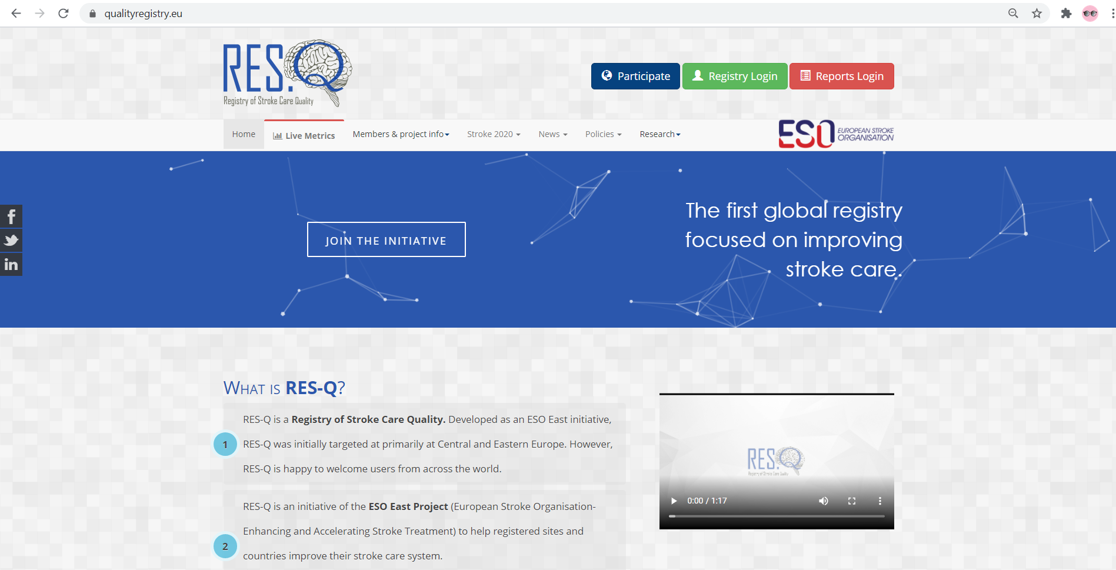
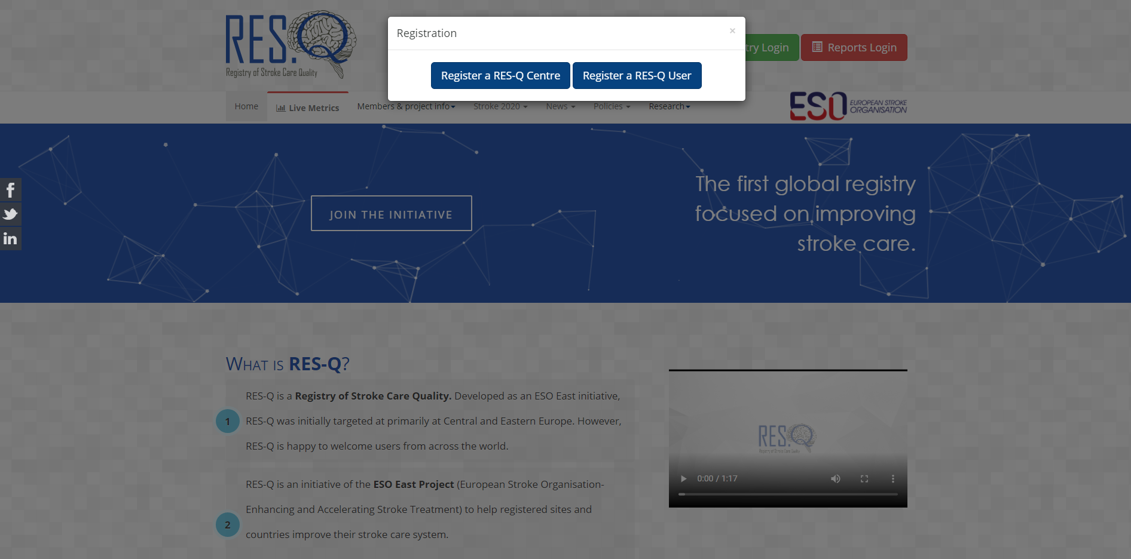
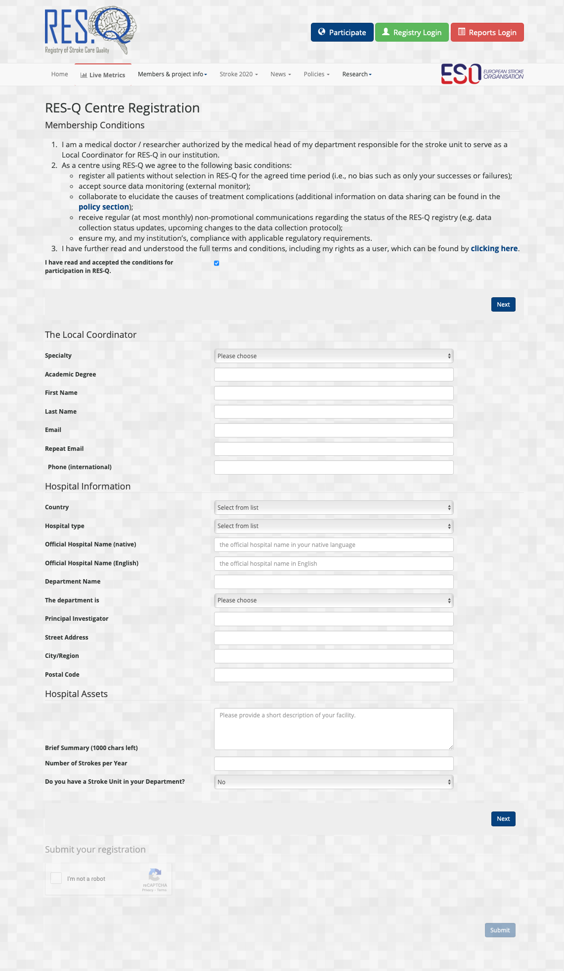
How to register as user centre/ hospital as a local coordinator in just 4 simple steps
Step 3: Click check box to agree on terms & conditions
Step 1: Click on participate
Step 2: Register RES-Q centre
Fill in your credentials
Step 4: Click on submit

Slide 7
RES-Q functionalities
How to register your center/ hospital as a local coordinator
How to register a user to the registered centre/ hospital
How a local coordinator/ user login to their centre/ hospital
How to register
a new patient
Using dashboard to monitor performance of your center/ hospital
SLIDES 4-5
SLIDE 7
SLIDE 9
SLIDE 11-13
SLIDES 15-18
How to use download function and download reports
Monitoring trends in stroke care quality
Using RES-Q to obtain WSO/ ESO angels awards
RES-Q policies including data sharing/data privacy
RES-Q team and contact
SLIDES 20-22
SLIDES 24-25
SLIDES 27-30
SLIDES 32-34
SLIDE 36
Notes:
Cómo registrar el centro/hospital como coordinador local (slides 4 & 5)
Cómo registrar un usuario en el centro/hospital registrado (slide 7)
Cómo inicia sesión un coordinador local/usuario en el centro/hospital (slide 9)
Cómo registrar un paciente nuevo (slides 11 - 13)
Uso del panel de control para monitorear el desempeño del centro/hospital (slides 15 - 18)
Cómo utilizar la función de descarga y descargar informes (slides 20 - 22)
Monitoreo de las tendencias en la calidad de atención de accidentes cerebrovasculares (slides 24 & 25)
Uso del RES-Q para recibir los premios Angels de la WSO/ ESO (slides 27 - 30)
Políticas del RES-Q que incluyen uso compartido de datos/privacidad de datos (slides 32 - 34)
Equipo y contacto del RES-Q (slide 36)

Slide 8
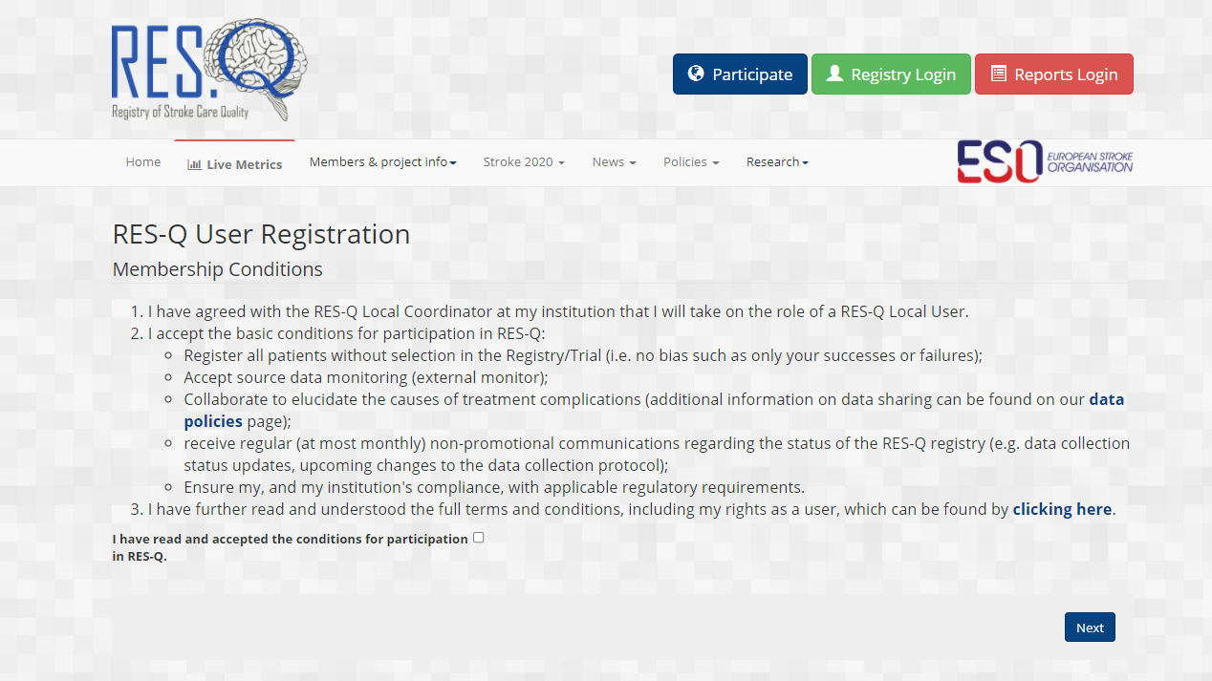
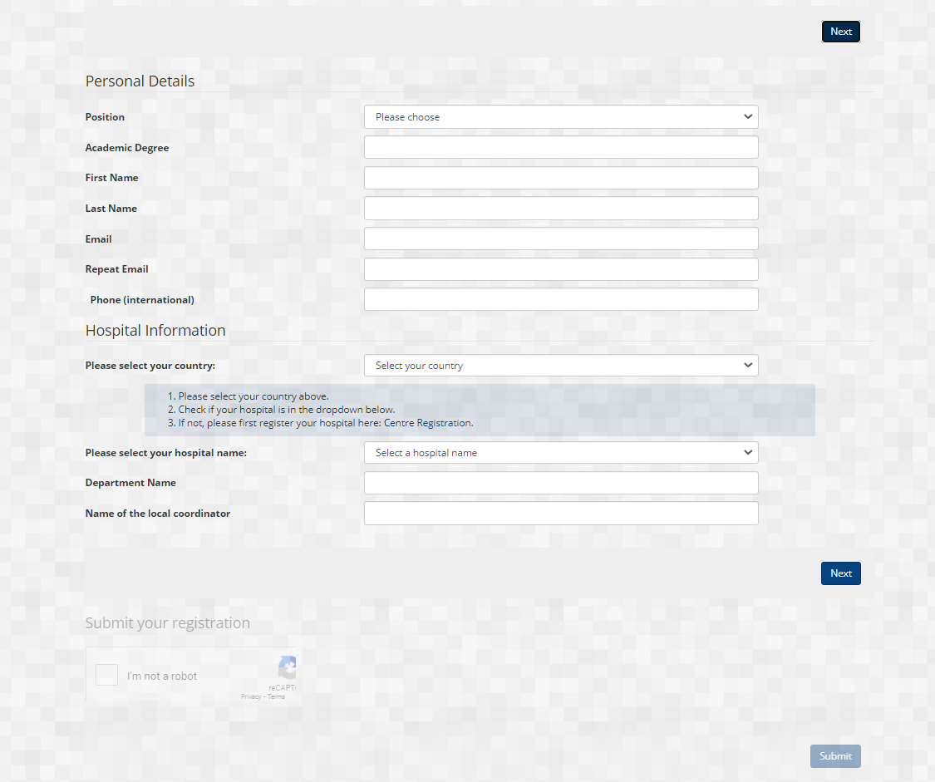
How to register a user to the registered centre/ hospital
Click the check box and then click NEXT
Click on participate
Click on register as
RES-Q user
Fill in your credentials, Select your country and hospital and submit

Slide 9
RES-Q functionalities
How to register your center/ hospital as a local coordinator
How to register a user to the registered centre/ hospital
How a local coordinator/ user login to their centre/ hospital
How to register
a new patient
Using dashboard to monitor performance of your center/ hospital
SLIDES 4-5
SLIDE 7
SLIDE 9
SLIDE 11-13
SLIDES 15-18
How to use download function and download reports
Monitoring trends in stroke care quality
Using RES-Q to obtain WSO/ ESO angels awards
RES-Q policies including data sharing/data privacy
RES-Q team and contact
SLIDES 20-22
SLIDES 24-25
SLIDES 27-30
SLIDES 32-34
SLIDE 36
Notes:
Cómo registrar el centro/hospital como coordinador local (slides 4 & 5)
Cómo registrar un usuario en el centro/hospital registrado (slide 7)
Cómo inicia sesión un coordinador local/usuario en el centro/hospital (slide 9)
Cómo registrar un paciente nuevo (slides 11 - 13)
Uso del panel de control para monitorear el desempeño del centro/hospital (slides 15 - 18)
Cómo utilizar la función de descarga y descargar informes (slides 20 - 22)
Monitoreo de las tendencias en la calidad de atención de accidentes cerebrovasculares (slides 24 & 25)
Uso del RES-Q para recibir los premios Angels de la WSO/ ESO (slides 27 - 30)
Políticas del RES-Q que incluyen uso compartido de datos/privacidad de datos (slides 32 - 34)
Equipo y contacto del RES-Q (slide 36)

Slide 10
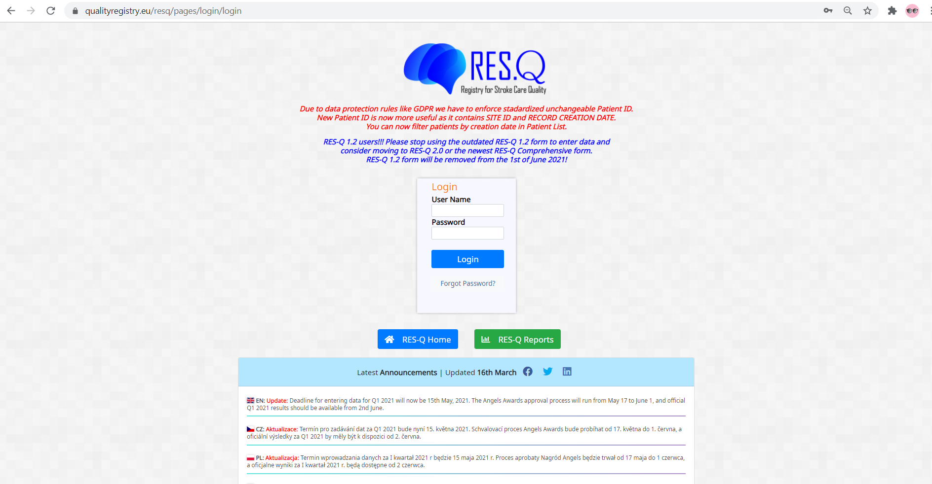
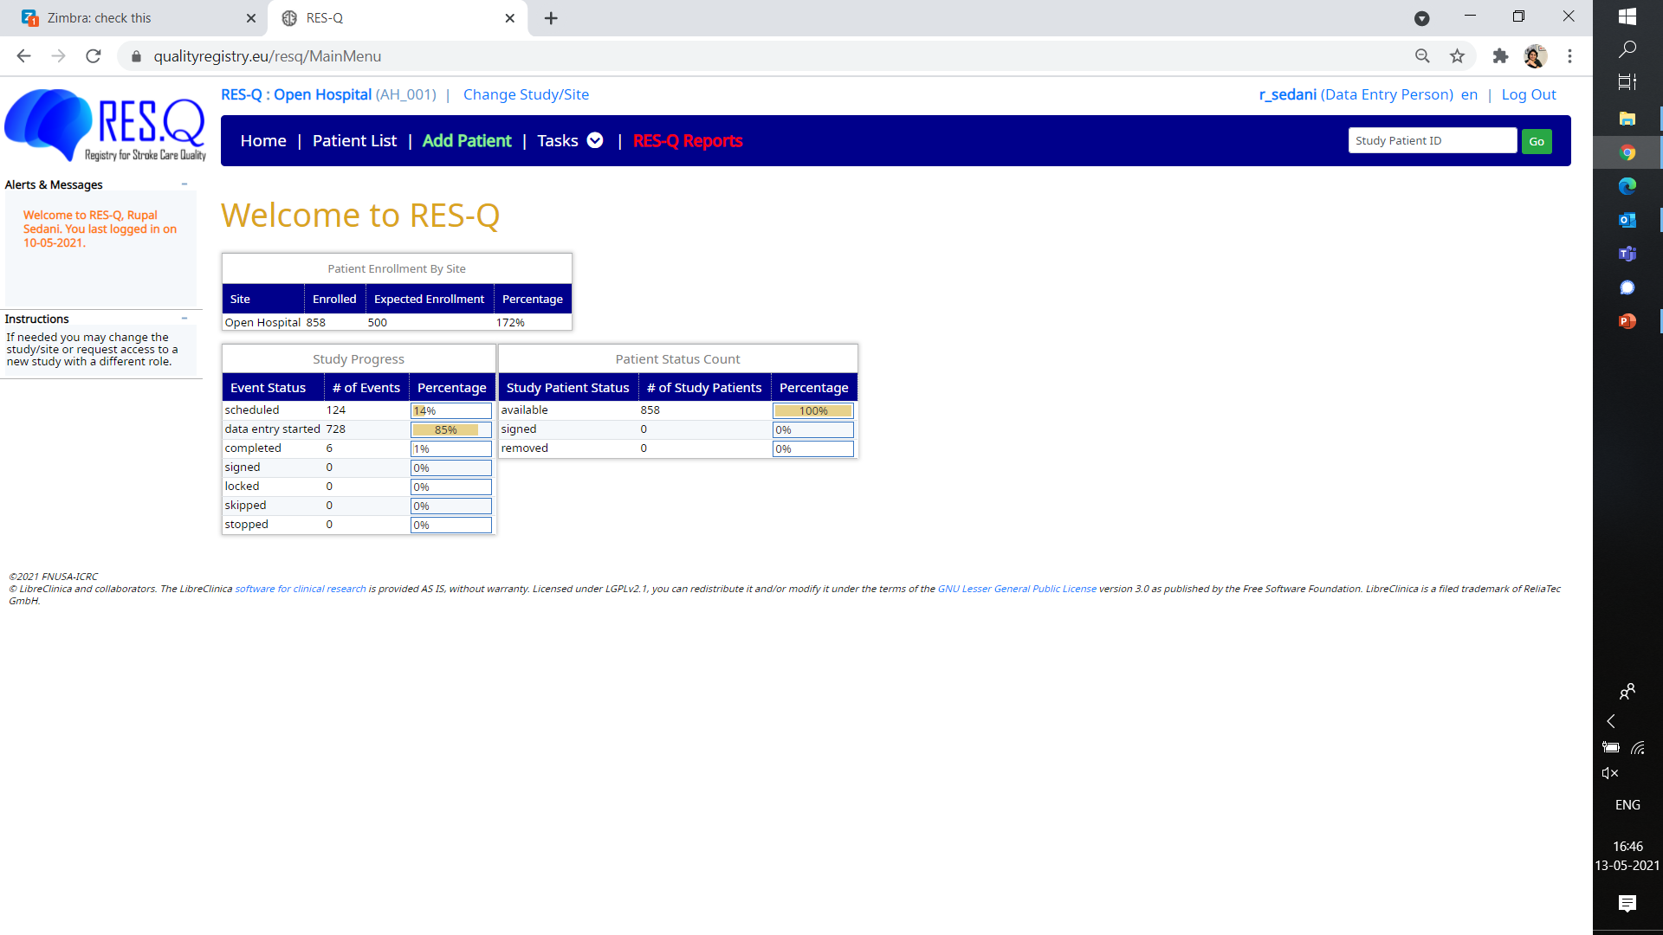
How to login to your centre/ hospital as either local coordinator or user
You will land on hospital home page to add/ view patient list
Enter your login credentials
Go to qualityregistry.eu and click on registry login

Slide 11
RES-Q functionalities
How to register your center/ hospital as a local coordinator
How to register a user to the registered centre/ hospital
How a local coordinator/ user login to their centre/ hospital
How to register
a new patient
Using dashboard to monitor performance of your center/ hospital
SLIDES 4-5
SLIDE 7
SLIDE 9
SLIDE 11-13
SLIDES 15-18
How to use download function and download reports
Monitoring trends in stroke care quality
Using RES-Q to obtain WSO/ ESO angels awards
RES-Q policies including data sharing/data privacy
RES-Q team and contact
SLIDES 20-22
SLIDES 24-25
SLIDES 27-30
SLIDES 32-34
SLIDE 36
Notes:
Cómo registrar el centro/hospital como coordinador local (slides 4 & 5)
Cómo registrar un usuario en el centro/hospital registrado (slide 7)
Cómo inicia sesión un coordinador local/usuario en el centro/hospital (slide 9)
Cómo registrar un paciente nuevo (slides 11 - 13)
Uso del panel de control para monitorear el desempeño del centro/hospital (slides 15 - 18)
Cómo utilizar la función de descarga y descargar informes (slides 20 - 22)
Monitoreo de las tendencias en la calidad de atención de accidentes cerebrovasculares (slides 24 & 25)
Uso del RES-Q para recibir los premios Angels de la WSO/ ESO (slides 27 - 30)
Políticas del RES-Q que incluyen uso compartido de datos/privacidad de datos (slides 32 - 34)
Equipo y contacto del RES-Q (slide 36)

Slide 12
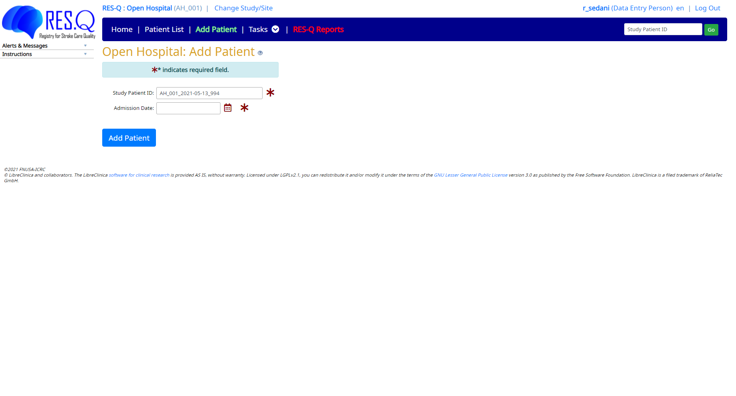
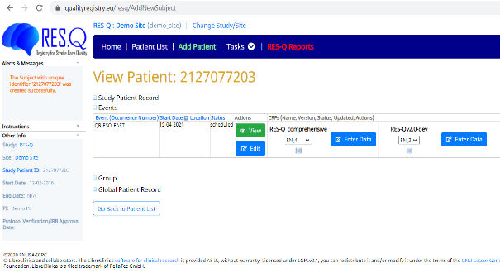
How to add a new patient
Patient id is auto generated
Click on Add Patient
After selecting admission date, click on add patient
You can select basic or comprehensive form & click on enter data

Slide 13
You can choose from 2 forms for monitoring
RES-Q Basic 2.0
RES-Q Comprehensive
Major difference v/s Basic form
Capture what type of imaging in detail and not just CT or MRI
Captures molecules prescribed instead of anti platelets/ anti coagulants
Captures follow up MRS after 3 months of discharge

Slide 14
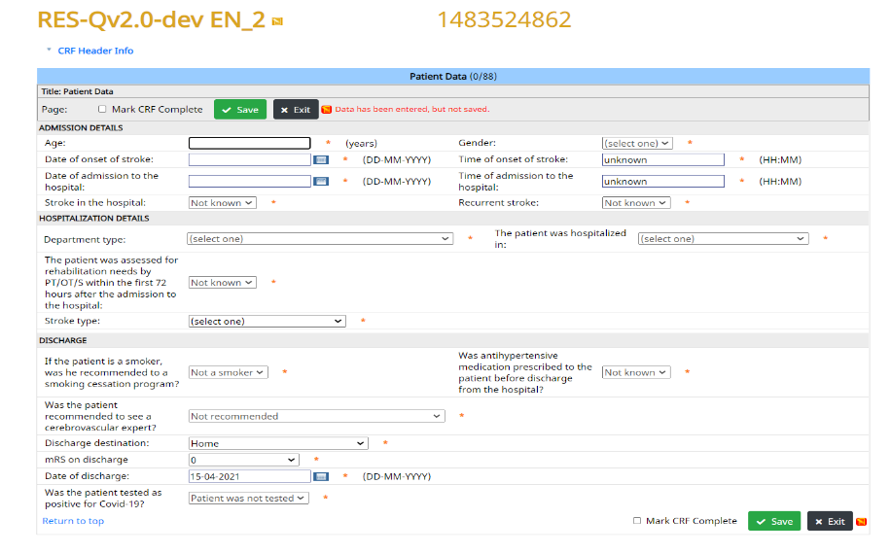
Start entering patient information in the form
Once you fill the patient details you click on Mark CRF complete

Slide 15
RES-Q functionalities
How to register your center/ hospital as a local coordinator
How to register a user to the registered centre/ hospital
How a local coordinator/ user login to their centre/ hospital
How to register
a new patient
Using dashboard to monitor performance of your center/ hospital
SLIDES 4-5
SLIDE 7
SLIDE 9
SLIDE 11-13
SLIDES 15-18
How to use download function and download reports
Monitoring trends in stroke care quality
Using RES-Q to obtain WSO/ ESO angels awards
RES-Q policies including data sharing/data privacy
RES-Q team and contact
SLIDES 20-22
SLIDES 24-25
SLIDES 27-30
SLIDES 32-34
SLIDE 36
Notes:
Cómo registrar el centro/hospital como coordinador local (slides 4 & 5)
Cómo registrar un usuario en el centro/hospital registrado (slide 7)
Cómo inicia sesión un coordinador local/usuario en el centro/hospital (slide 9)
Cómo registrar un paciente nuevo (slides 11 - 13)
Uso del panel de control para monitorear el desempeño del centro/hospital (slides 15 - 18)
Cómo utilizar la función de descarga y descargar informes (slides 20 - 22)
Monitoreo de las tendencias en la calidad de atención de accidentes cerebrovasculares (slides 24 & 25)
Uso del RES-Q para recibir los premios Angels de la WSO/ ESO (slides 27 - 30)
Políticas del RES-Q que incluyen uso compartido de datos/privacidad de datos (slides 32 - 34)
Equipo y contacto del RES-Q (slide 36)

Slide 16
Using dashboard to monitor performance of your center/ hospital
Dashboards are tools that allow you to monitor Quality of Stroke care in your center with real time analysis
Advantages:
Anytime access to your data and results
Able to view progressive data on all key parameters measured for stroke
Data download option in 3 forms; PowerPoint, Excel and raw data
Benchmarking the hospital performance with the country average

Slide 17
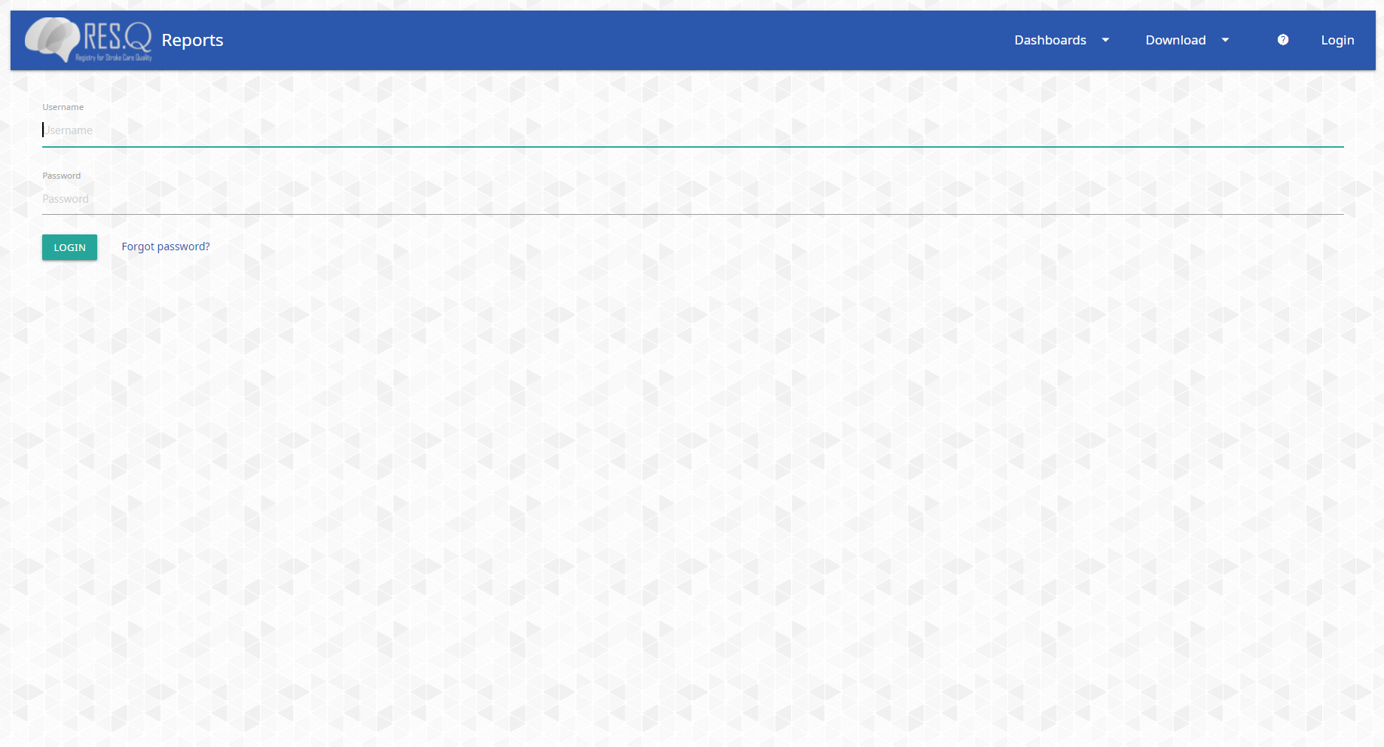
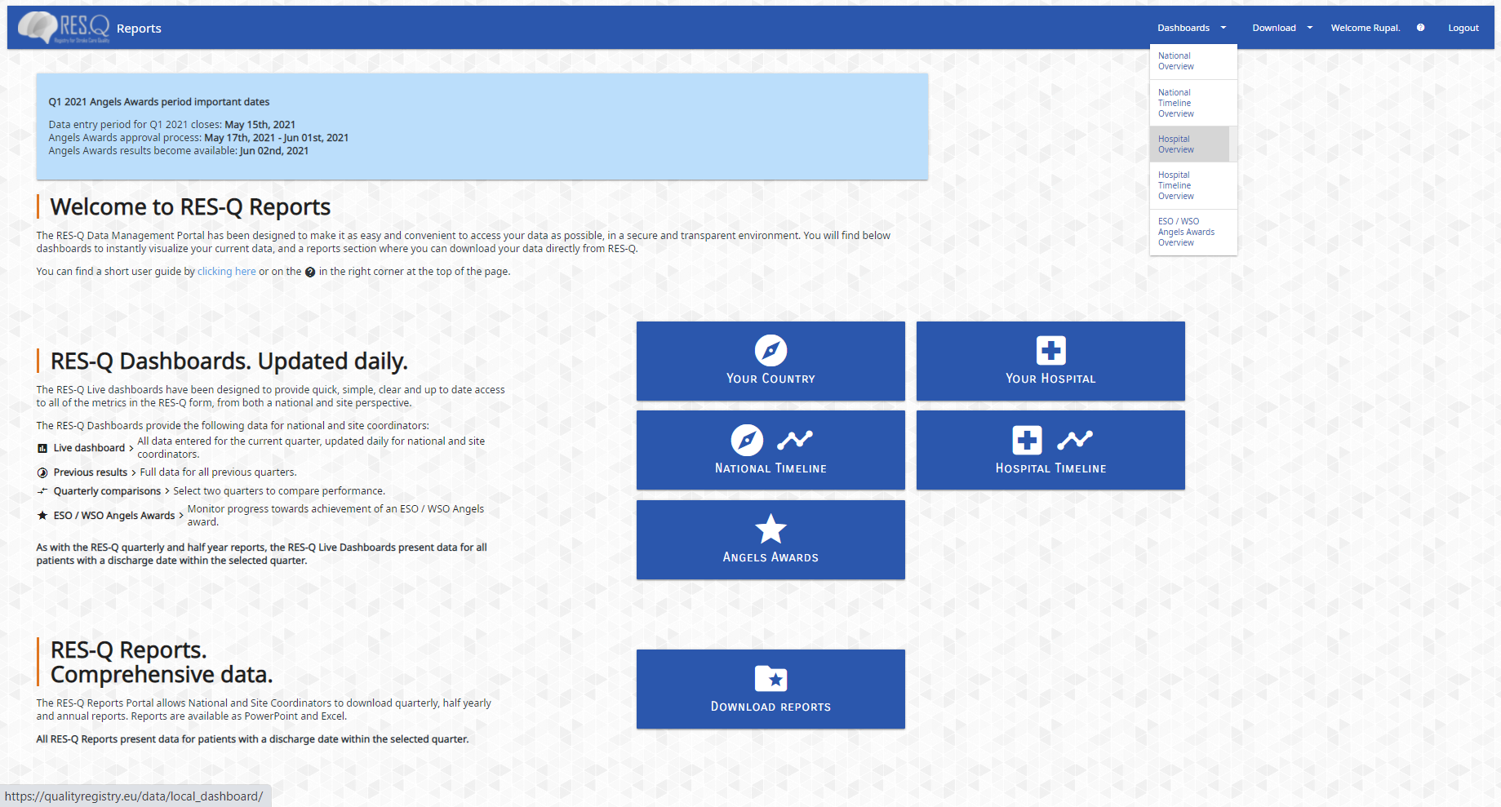
Using dashboard to monitor performance of your centre/ hospital
Login with your RES-Q credentials
Click on hospital overview

Slide 18
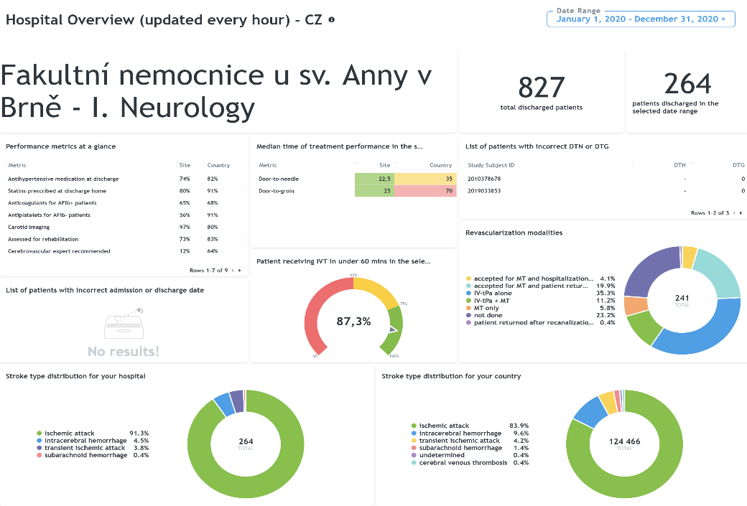
Hospital Name
You can view performance on key metrics

Slide 19
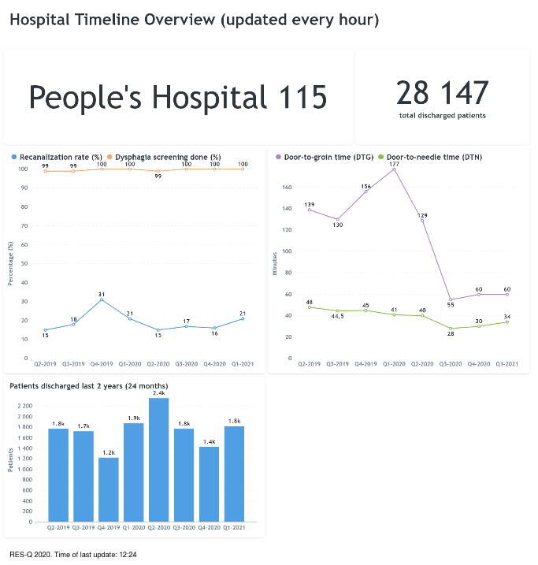
Hospital Name
You can view progression of key parameters like DTN, DTG, recanalisation rate

Slide 20
RES-Q functionalities
How to register your center/ hospital as a local coordinator
How to register a user to the registered centre/ hospital
How a local coordinator/ user login to their centre/ hospital
How to register
a new patient
Using dashboard to monitor performance of your center/ hospital
SLIDES 4-5
SLIDE 7
SLIDE 9
SLIDE 11-13
SLIDES 15-18
How to use download function and download reports
Monitoring trends in stroke care quality
Using RES-Q to obtain WSO/ ESO angels awards
RES-Q policies including data sharing/data privacy
RES-Q team and contact
SLIDES 20-22
SLIDES 24-25
SLIDES 27-30
SLIDES 32-34
SLIDE 36
Notes:
Cómo registrar el centro/hospital como coordinador local (slides 4 & 5)
Cómo registrar un usuario en el centro/hospital registrado (slide 7)
Cómo inicia sesión un coordinador local/usuario en el centro/hospital (slide 9)
Cómo registrar un paciente nuevo (slides 11 - 13)
Uso del panel de control para monitorear el desempeño del centro/hospital (slides 15 - 18)
Cómo utilizar la función de descarga y descargar informes (slides 20 - 22)
Monitoreo de las tendencias en la calidad de atención de accidentes cerebrovasculares (slides 24 & 25)
Uso del RES-Q para recibir los premios Angels de la WSO/ ESO (slides 27 - 30)
Políticas del RES-Q que incluyen uso compartido de datos/privacidad de datos (slides 32 - 34)
Equipo y contacto del RES-Q (slide 36)

Slide 21
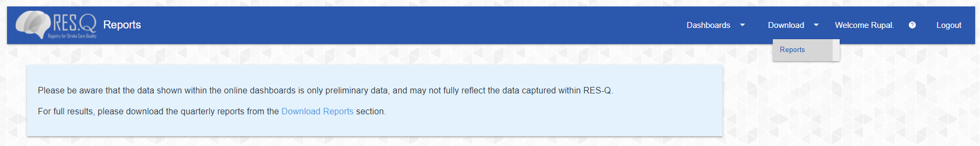
How to download your hospital reports
Click on download reports

Slide 22
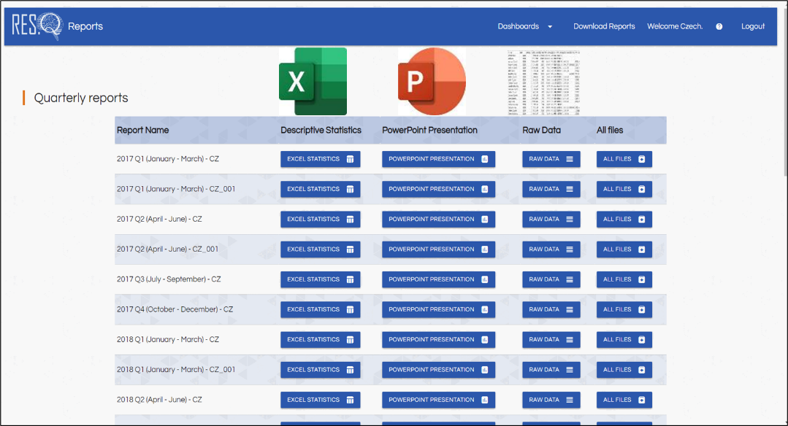
RES-Q offers hospitals ease of downloading ready to use reports in 3 formats
Excel, PowerPoint and Raw Data
Click on download reports

Slide 23
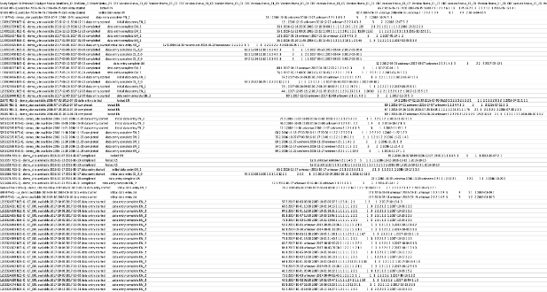
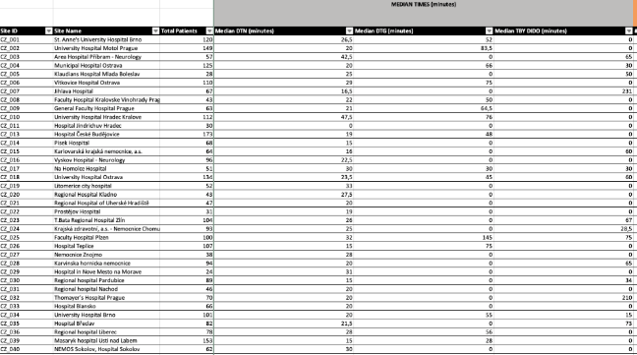
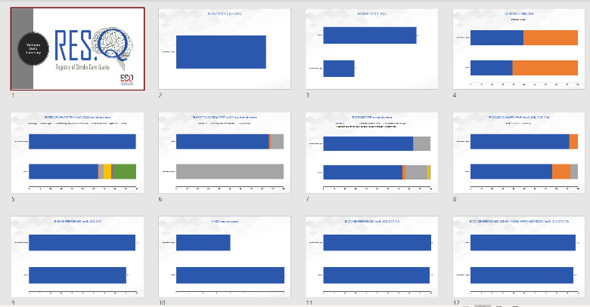
Excel, PowerPoint and raw data in the form of quarterly, biannually and yearly report
Raw Data
Excel Format
PPT Format

Slide 24
Fucionalidade do RES-Q
How to register your center/ hospital as a local coordinator
How to register a user to the registered centre/ hospital
How a local coordinator/ user login to their centre/ hospital
How to register
a new patient
Using dashboard to monitor performance of your center/ hospital
SLIDES 4-5
SLIDE 7
SLIDE 9
SLIDE 11-13
SLIDES 15-18
How to use download function and download reports
Monitoring trends in stroke care quality
Using RES-Q to obtain WSO/ ESO angels awards
RES-Q policies including data sharing/data privacy
RES-Q team and contact
SLIDES 20-22
SLIDES 24-25
SLIDES 27-30
SLIDES 32-34
SLIDE 36
Notes:
Cómo registrar el centro/hospital como coordinador local (slides 4 & 5)
Cómo registrar un usuario en el centro/hospital registrado (slide 7)
Cómo inicia sesión un coordinador local/usuario en el centro/hospital (slide 9)
Cómo registrar un paciente nuevo (slides 11 - 13)
Uso del panel de control para monitorear el desempeño del centro/hospital (slides 15 - 18)
Cómo utilizar la función de descarga y descargar informes (slides 20 - 22)
Monitoreo de las tendencias en la calidad de atención de accidentes cerebrovasculares (slides 24 & 25)
Uso del RES-Q para recibir los premios Angels de la WSO/ ESO (slides 27 - 30)
Políticas del RES-Q que incluyen uso compartido de datos/privacidad de datos (slides 32 - 34)
Equipo y contacto del RES-Q (slide 36)

Slide 25
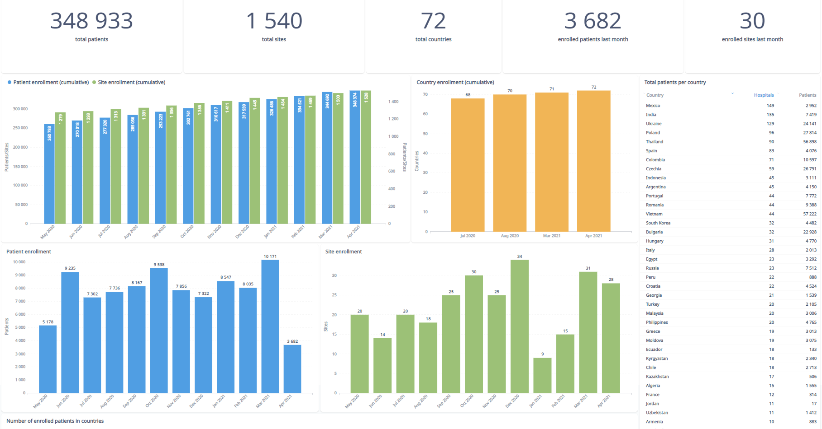
RES-Q live metrics, updated every hour
Everyone can view this data on the RES-Q website homepage

Slide 26
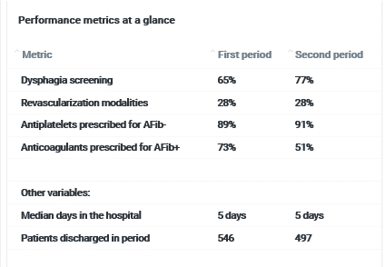
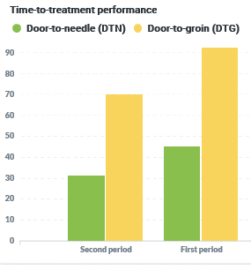
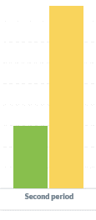
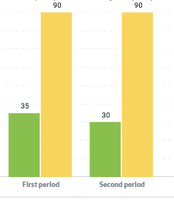
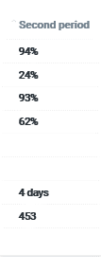
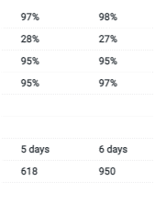

You can monitor quarterly trends and see progression on key parameters
Q3 2019
Q4 2019
Q1 2020
Q2 2020
Q3 2020
Q4 2020
(n)
Q3 2019
Q4 2019
Q1 2020
Q2 2020
Q3 2020

Slide 27
RES-Q functionalities
How to register your center/ hospital as a local coordinator
How to register a user to the registered centre/ hospital
How a local coordinator/ user login to their centre/ hospital
How to register
a new patient
Using dashboard to monitor performance of your center/ hospital
SLIDES 4-5
SLIDE 7
SLIDE 9
SLIDE 11-13
SLIDES 15-18
How to use download function and download reports
Monitoring trends in stroke care quality
Using RES-Q to obtain WSO/ ESO angels awards
RES-Q policies including data sharing/data privacy
RES-Q team and contact
SLIDES 20-22
SLIDES 24-25
SLIDES 27-30
SLIDES 32-34
SLIDE 36
Notes:
Cómo registrar el centro/hospital como coordinador local (slides 4 & 5)
Cómo registrar un usuario en el centro/hospital registrado (slide 7)
Cómo inicia sesión un coordinador local/usuario en el centro/hospital (slide 9)
Cómo registrar un paciente nuevo (slides 11 - 13)
Uso del panel de control para monitorear el desempeño del centro/hospital (slides 15 - 18)
Cómo utilizar la función de descarga y descargar informes (slides 20 - 22)
Monitoreo de las tendencias en la calidad de atención de accidentes cerebrovasculares (slides 24 & 25)
Uso del RES-Q para recibir los premios Angels de la WSO/ ESO (slides 27 - 30)
Políticas del RES-Q que incluyen uso compartido de datos/privacidad de datos (slides 32 - 34)
Equipo y contacto del RES-Q (slide 36)

Slide 28
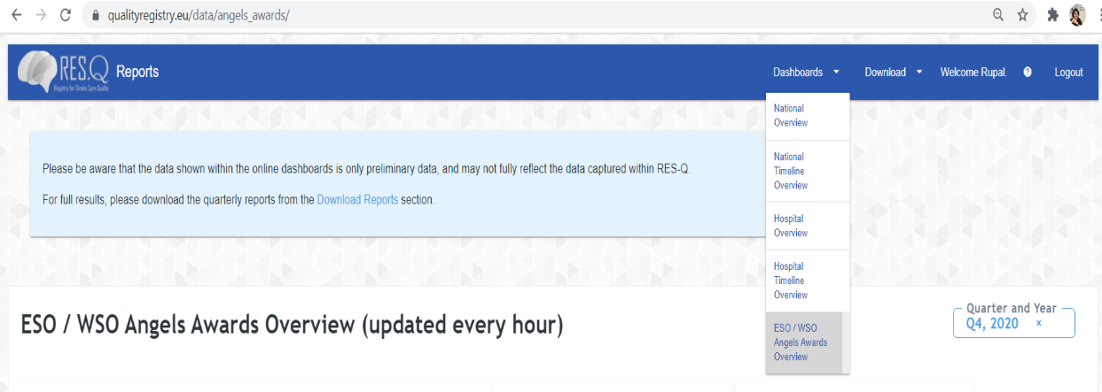
Using RES-Q to obtain WSO/ ESO angels awards

Slide 29
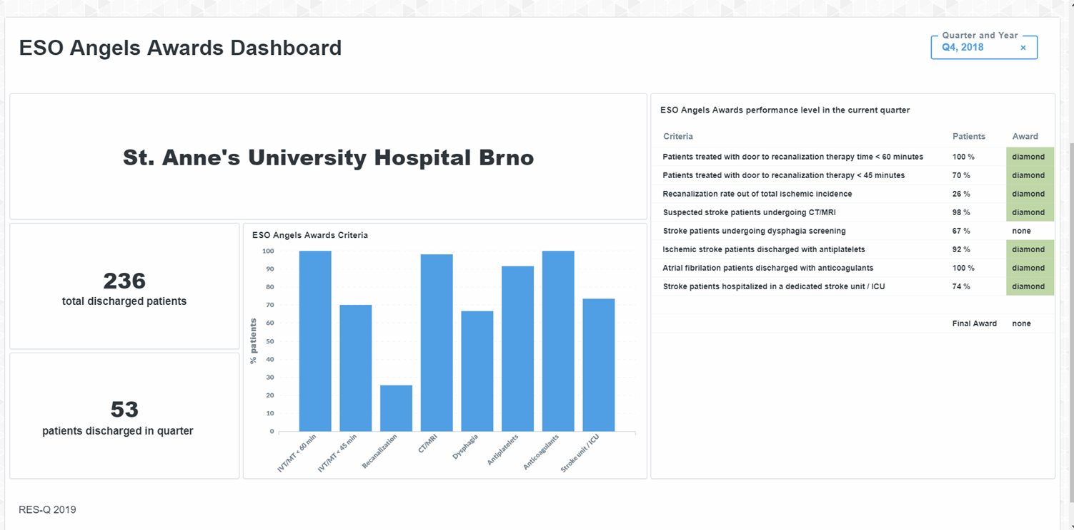
Site dashboard with WSO/ ESO angels awards criteria, updated hourly
Nombre del hospital

Slide 30









How the award process works
Quarterly WSO/ ESO angels Award announcement
Hospital monitors and enters data in RES-Q on a continuous basis
Data gets automatically stored in RES-Q database with live dashboards
Award portal updated at end of every quarter & notified to NC
RES-Q national coordinators validates & approves
Post approval from NC sent to ESO/ WSO committee for final approval
Continuous process
10 days
Updated real time

Slide 31




Being part of RES-Q registry allows you to participate in the quarterly WSO/ ESO angels awards, given to qualifying hospitals for delivering excellence in stroke care
WSO/ ESO KPIs/ criteria | GOLD STATUS | PLATINUM STATUS | DIAMOND STATUS
Registration requirements | Registration criteria met | Registration criteria met | Registration criteria met
% of patients treated with door to needle time < 60 minutes | 50 % | 75 % | 75 %
% of patients treated with door to groin time < 120 minutes | 50 % | 75 % | 75 %
% of patients treated with door to needle time < 45 minutes |  |  | 50 %
% of patients treated with door to groin time < 90 minutes |  |  | 50 %
% recanalization procedure rate out of total stroke incidence in the hospital | 5 % | 15 % | 25 %
% of all suspected stroke patients undergoing CT or MRI imaging procedure | 80 % | 85 % | 90 %
% of all stroke patients undergoing dysphagia screen | 80 % | 85 % | 90 %
% of ischaemic stroke patients discharged with antiplatelets | 80 % | 85 % | 90 %
% of atrial fibrillation related stroke patients discharged with anticoagulants | 80 % | 85 % | 90 %
Stroke patients treated in a dedicated stroke unit or ICU during their hospital stay |  |  | SI

Slide 32
RES-Q functionalities
How to register your center/ hospital as a local coordinator
How to register a user to the registered centre/ hospital
How a local coordinator/ user login to their centre/ hospital
How to register
a new patient
Using dashboard to monitor performance of your center/ hospital
SLIDES 4-5
SLIDE 7
SLIDE 9
SLIDE 11-13
SLIDES 15-18
How to use download function and download reports
Monitoring trends in stroke care quality
Using RES-Q to obtain WSO/ ESO angels awards
RES-Q policies including data sharing/data privacy
RES-Q team and contact
SLIDES 20-22
SLIDES 24-25
SLIDES 27-30
SLIDES 32-34
SLIDE 36
Notes:
Cómo registrar el centro/hospital como coordinador local (slides 4 & 5)
Cómo registrar un usuario en el centro/hospital registrado (slide 7)
Cómo inicia sesión un coordinador local/usuario en el centro/hospital (slide 9)
Cómo registrar un paciente nuevo (slides 11 - 13)
Uso del panel de control para monitorear el desempeño del centro/hospital (slides 15 - 18)
Cómo utilizar la función de descarga y descargar informes (slides 20 - 22)
Monitoreo de las tendencias en la calidad de atención de accidentes cerebrovasculares (slides 24 & 25)
Uso del RES-Q para recibir los premios Angels de la WSO/ ESO (slides 27 - 30)
Políticas del RES-Q que incluyen uso compartido de datos/privacidad de datos (slides 32 - 34)
Equipo y contacto del RES-Q (slide 36)

Slide 33
Data Policies and Data Privacy
We strive for transparency and fairness.
Hospitals can access their own data, including raw (patient rows) data.
The National Coordinator / National Steering Committee (NC / NSC) can see all country level data and results, unless otherwise specified by the country.
All current data policies are available on our website, in English language only at: https://qualityregistry.eu/policies
As an ESO project, our policies are audited by them.
RES-Q was determined to satisfy compliance with GDPR and other applicable laws, according to ESO.
Policies
The RES-Q platform’s usage, privacy, and data protection policies, as well as the updated terms and conditions, are effective as of May 25th, 2018. The relevant documents published here are:
Privacy Policy: A description of what personal data is collected from users in RES-Q, how that data is managed, and what rights users have
Terms & Conditions: The list of rights and responsibilities users must agree to, and comply with, in order to be authorised to use RES-Q
Data Security Policy: A detailed description of how RES-Q stores and handles data from a technical perspective
Data Sharing & Ownership Policy: This describes the broad categories of data stored in RES-Q and how they are used towards the collaborative purpose of the platform
Data Request Policy: The requirements and procedures for requesting Access to data stored in RES-Q for research or evaluation purposes

Slide 34
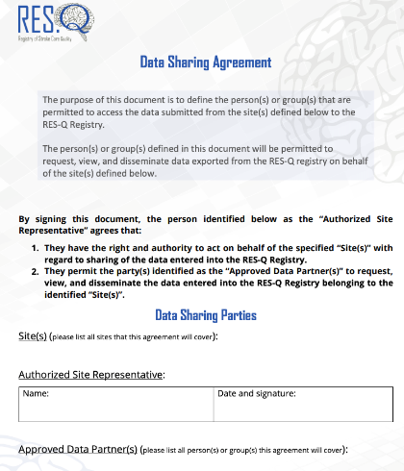
Third Party Access
Access to data is NOT granted to third parties, unless the NC / NSC signs an agreement form providing them access to the data (e.g. to individual angels consultant).
Access to data to third parties can also be granted per hospital, with the same data agreement between the Local Coordinator and the third party.
You can find the Data Sharing Agreement form below https://qualitiregistry.eu/images/forms/RES_Q_Data_Sharing_Agreement.pdf

Slide 35
RES-Q data coverage - Methodology
To evaluate how large share of stroke cases RES-Q covers in each country, we can compare the number of RES-Q records to total stroke cases collected by Global Burden of Diseases (GBD) (The Institute for Health Metrics and Evaluation (IHME), University of Washington, WA, USA). http://www.healthdata.org/gbd/2019.
It is not necessary to have all stroke cases in a particular country, but only statistical sample representing the population of stroke cases.
Proper sample size can be easily guessed by using simple rules that its sample size should be around 10% of the whole population, but at least of size 100 and at most 1000.
This simply approach is not very scientific, but we can calculate the sample required size and describe this size selection using statistics: confidence level and margin of error.
We used the most common confidence level of 95% and margin of error of 5%.
A margin of error tells you how many percentage points your results will differ from the real population value. For example, a 95% confidence interval with a 5 percent margin of error means that your statistic will be within 5 percentage points of the real population value 95% of the time.

Slide 36
RES-Q functionalities
How to register your center/ hospital as a local coordinator
How to register a user to the registered centre/ hospital
How a local coordinator/ user login to their centre/ hospital
How to register
a new patient
Using dashboard to monitor performance of your center/ hospital
SLIDES 4-5
SLIDE 7
SLIDE 9
SLIDE 11-13
SLIDES 15-18
How to use download function and download reports
Monitoring trends in stroke care quality
Using RES-Q to obtain WSO/ ESO angels awards
RES-Q policies including data sharing/data privacy
RES-Q team and contact
SLIDES 20-22
SLIDES 24-25
SLIDES 27-30
SLIDES 32-34
SLIDE 36
Notes:
Cómo registrar el centro/hospital como coordinador local (slides 4 & 5)
Cómo registrar un usuario en el centro/hospital registrado (slide 7)
Cómo inicia sesión un coordinador local/usuario en el centro/hospital (slide 9)
Cómo registrar un paciente nuevo (slides 11 - 13)
Uso del panel de control para monitorear el desempeño del centro/hospital (slides 15 - 18)
Cómo utilizar la función de descarga y descargar informes (slides 20 - 22)
Monitoreo de las tendencias en la calidad de atención de accidentes cerebrovasculares (slides 24 & 25)
Uso del RES-Q para recibir los premios Angels de la WSO/ ESO (slides 27 - 30)
Políticas del RES-Q que incluyen uso compartido de datos/privacidad de datos (slides 32 - 34)
Equipo y contacto del RES-Q (slide 36)

Slide 37

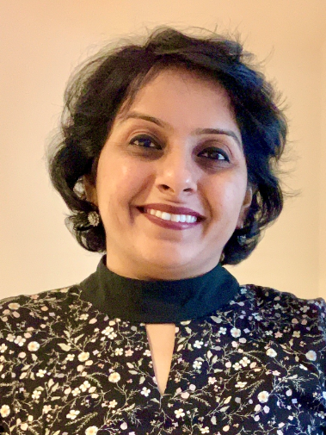





RES-Q core team is based out of International Clinical Research Centre at St Anne university hospital, Brno, Czech Republic
Prof. Robert Mikulik
Stroke Program Director & Founder of RES-Q
Rupal Sedani
RES-Q Registry manager
Vaclav Pasacek
Senior software developer
Miroslav Varecha
Data scientist
Veronika Svobodova
Stroke Program Manager
Sabina Hladikova
Project coordinator

Slide 38
Let us help you improve quality of stroke care with RES-Q
One patient at a time
For more information visit us at www.qualityregistry.eu or write to admin@qualityregistry.eu

